Slide 1
Evaluation of cognitive functions among Lebanese patients with schizophrenia
Presented by
Chadia Haddad (PhD)
THURSDAY 13 October 2022
At 4:30 (Morocco Time)
19th Congress of the WPA Epidemiology and Public Health Section
Marrakech, Morocco, 12-14 October, 2022

Slide 2
Definition
Schizophrenia is a mental disorder characterized by disruptions in thought processes, perceptions, emotional responsiveness, and social interactions
Schizophrenia is typically a persistent disease and can be severe and disabling
Symptoms of schizophrenia
Positive symptoms : hallucinations, delusions, and thought disorder
Negative symptoms : reduced expression of emotions, reduced motivation to accomplish goals, difficulty in social relationships
The worldwide prevalence of schizophrenia is between 0.7 - 1%.
Starts at an early age between 18 – 25 years old
Occurs more often in males

Slide 3
Epidemiology of Schizophrenia
In Arab Countries
Prevalence of psychotic disorders: between 0.7% and 5.6% without gender difference. (Ref: Saab R, Moussaoui D, Tabet CC, El Hamaoui Y, Salamoun MM, Mneimneh ZN, Karam EG. Epidemiology of schizophrenia and related disorders in the Arab World. Arab J Psychiatry. 2011;22:1-9).
Depression and anxiety disorders are the most common mental disorders.
Distribution of disability-adjusted life-years (DALYs) due to mental disorders in the Eastern Mediterranean Region, 2015
(d’après Global Burden of Disease Study 2015, Eastern Mediterranean Region, 2015)
In Lebanon
More than 25% of people are affected by mental and behavioral disorders. (Ref: Chahine LM, Chemali Z. Report: Mental health care in Lebanon: policy, plans and programmes. Information for authors. 1995;1).
Schizotypal and Delusional Disorders (47%) and Mood Disorders (12%) are the most common diagnosis for admission to psychiatric hospitals
The prevalence of schizophrenia in Lebanon is still not estimated
Percent of Global DALYs within the mental disorders category (2010)
(d’après Republic of Lebanon. Ministry of Public Health. Mental Health and Substance Use Strategy for Lebanon 2015 - 2020).

Slide 4
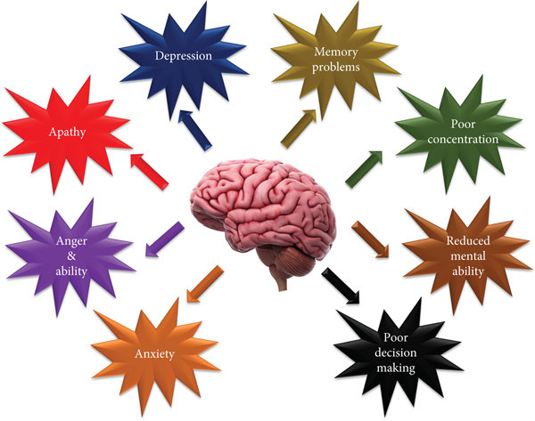
Cognitive function among patients with schizophrenia
Cognitive deficits are a core feature of schizophrenia, affecting up to 75% of patients
Schizophrenia affects a wide range of cognitive functions, particularly
Attention,
Working memory
Verbal learning and memory
Speech fluency
Executive functions
Cognitive impairment occurred at all clinical stages and throughout life
Most schizophrenic patients demonstrate at least one cognitive impairment

Slide 5
Cognitive Assessment Instruments
Cognitive assessment is one of the best indicators of the functional and social prognosis of schizophrenic patients
Assessment methods involve batteries and screening tests
Batteries of neuropsychological tests
BACS
(Brief Assessment of Cognition in Schizophrenia )
MATRICS
(Measurement and Treatment Research to Improve Cognition in Schizophrenia)
WAIS
(Wechsler Adult Intelligence Scale)
Rapid Screening Tools
MOCA
(Montreal Cognitive Assessment)
RBANS
(Repeatable Battery for the Assessment of Neuropsychological Status)
CANTAB
(Cambridge Neuropsychological Test Automated Battery
MMSE
(Mini–Mental State Examination)
BCA
(Brief Cognitive Assessment )
SCIP
(Screen for Cognitive Impairment in Psychiatry)
B-CATS
(Brief Cognitive Assessment Tool for Schizophrenia)

Slide 6
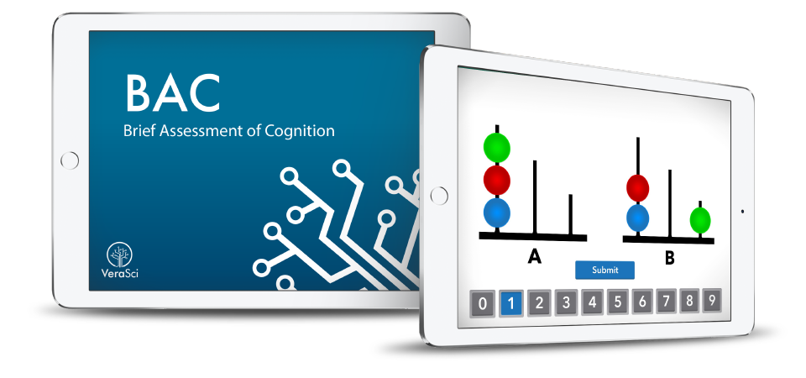
Brief Assessment of Cognition In Schizophrenia (BACS) Battery
6 tests that measure 6 cognitive domains
Short duration (≈35 min)
Quick and Short
Easily used by medical professionals
Evaluates the main cognitive functions impaired in SCZ
S
 | Domaines cognitifs | Tests
1 | Verbal Memory | List learning test (15 words)
2 | Working Memory | Digit sequencing
3 | Motor Speed | Token motor task
4 | Speed Of Information Processing | Symbol coding
5 | Verbal Fluency | Verbal fluency
6 | Executive Functions | Tower of London
Haddad C, Salameh P, Hallit S, Obeid S, Haddad G, Clément JP, Calvet B. Cross-cultural adaptation and validation of the Arabic version of the BACS scale (the brief assessment of cognition in schizophrenia) among chronic schizophrenic inpatients. BMC psychiatry. 2021 Dec;21(1):1-2.

Slide 7
Montreal Cognitive Assessment (MOCA) test
The MoCA is a rapid screening tool (10 min) that assess cognitive impairment in elderly
It is mainly dedicated to screening for mild cognitive impairment
The items assessed are grouped into six subsections:
Short term memory
Visuospatial skills
Executive functions
Attention, concentration, working memory
Speech
Orientation in time and space
(Nasreddine ZS, Phillips NA, Bédirian V, Charbonneau S, Whitehead V, Collin I, Cummings JL, Chertkow H. The Montreal Cognitive Assessment, MoCA: a brief screening tool for mild cognitive impairment. Journal of the American Geriatrics Society. 2005 Apr;53(4):695-9)
Haddad C, Salameh P, Sacre H, Clément JP, Calvet B. The use of the Montreal Cognitive Assessment (MoCA) screening tool to evaluate cognitive deficits in Lebanese in-patients with schizophrenia. Asian Journal of Psychiatry. 2022 Apr 1;70:103029.

Slide 8
Self perception of cognitive functioning
Patients with schizophrenia have difficulties to self-evaluate their cognitive function (neurocognitive and social cognitive domains).
Patients with schizophrenia have a particularly low level of insight into their illness compared to healthy people.
Misestimating the ability of patients with schizophrenia can be either by
overestimating or underestimating it in about equal proportions across cognitive domains
The importance of self-perception assessment
Enables one to become aware of their symptoms and address the negative effects in everyday life.
Improves the therapeutic connection and the patient's desire to receive care, especially in cognitive rehabilitation
If patients could reliably report their own cognitive issues
this could help with the planning of functional outcomes and individual treatments
Haddad C, Salameh P, Hallit S, Sacre H, Clément JP, Calvet B. Self-assessment of social cognition in a sample of Lebanese in-patients with schizophrenia. Schizophrenia Research: Cognition. 2021 Dec 1;26:100207.
Haddad C, Salameh P, Sacre H, Polin C, Clément JP, Calvet B. Subjective cognitive complaints and relations to objective cognitive performance among Lebanese patients with schizophrenia. BMC psychiatry. 2021 Dec;21(1):1-4.

Slide 9
Problem statement
Few studies have been done in the Arab countries that evaluate the cognitive impairment in patients with schizophrenia
In Lebanon, some studies evaluated cognitive function in older people.
However, no study was done to assess cognitive functions (objective and self-report ) in individuals with neurological or psychiatric diseases.
Clinicians had limited options, since they had to rely on untranslated assessments or translations that had not been validated.
Some neuropsychological batteries had been used locally among patients with schizophrenia to assess their cognition

Slide 10
Objectives of the study
To validate a diagnostic and screening tool for cognitive disorders among patients with schizophrenia
To evaluate subjective cognitive complaints and related factors among these patients.

Slide 11
methodology
Study design
Cross-sectional study
Performed at the “Psychiatric Hospital of the Cross – Lebanon (HPC)”,
Between July 2019 and March 2020
120 inpatients diagnosed with schizophrenia and schizoaffective disorders
60 healthy controls recruited from the staff of the HPC hospital
Participants
Inclusion criteria
Inpatients
Aged between 18-60 years
Having an educational level over five years
Meeting the “DSM-5 criteria (diagnostic and statistical manual of mental disorders, fifth edition)” for schizophrenia and schizoaffective disorders
Being treated with antipsychotics medication and clinically stable

Slide 12
methodology
Selection of participants
methodology
Schizophrenic subjects was selected using a randomized method from a list generated by the computer software
Healthy control were matched for age, education and sex with the patients group
The ratio of 2:1 was considered when selecting the participants:
120 patients with schizophrenia
60 healthy controls
Procedure
Two independent psychologists assessed the objective cognitive functions among participants
One specialized in the administration of the BACS battery
The other trained in the use of the standard battery
The assessment was done on two different days in less than 2 weeks
The two evaluators were blind to each other

Slide 13
methodology
Brief Assessment of Cognition In Schizophrenia (BACS) battery
Standard battery (tests designed to examine the same structures as the BACS).
16 item Free and Cued Recall test; Forward and Backward Digit Span Sequencing from the WAIS-IV; Trail Making Test A (TMT-A); Controlled Oral Word Association Test; Digit Symbol Coding from the WAIS-IV; Block Design Test from the WAIS-IV.
Montreal Cognitive Assessment (MOCA) test
Tests used to assess cognitive function
Scales used
PANSS : Positive and Negative Syndrome scale
CDSS : Calgary depression Scale for Schizophrenia
IS : Insight scale for Psychosis
ACSo : Self-Assessment of Social Cognitive Impairments
SASCCS : Self-Assessment Scale of Cognitive Complaints in Schizophrenia
ADL : Activities of Dailing Living

Slide 14
methodology
Data Analysis
SPSS version 25 software
Descriptive analysis of variables (mean ± standard deviation; frequencies and percentages)
Factor analysis to confirm the validity of the tests
Cronbach's Alpha to test internal consistency
Specificity and Sensitivity (ROC curve)
Pearson's correlation coefficients to calculate the relationship between the tests used
Student's t test for comparing two means and ANOVA for comparing three or more means
Multivariable regression analysis
The significance threshold was retained at p<0.05

Slide 15
Results
Sociodemographic characteristics
Healthy controls
was matched with the schizophrenia group according to sex, education level and age
Married participants with high monthly income and without any psychiatric illness were found in the control group as compared to the patient group.
Schizophrenia patients
Mean age 48.4 ± 7.6 years
59.2% males
81.9% were single
low monthly income (52.6%)
50% have a secondary level of education
36.5% have a family history of psychiatric illness
Duration of illness was 20.6 ± 12.4 years
Duration of hospitalization was 12.4 ± 8.5 years

Slide 16
Results
Validation of the BACS battery
Strong concurrent validity with a standard battery of cognitive Tests
Correlation coefficient = 0.73 in patient and 0.78 in control
High internal consistency
Cronbach’s alpha. (0.85)
Factor analysis for the BACS have produced a one-factor structure
High sensitivity (0.93) and specificity (0.86) to distinguish patients with schizophrenia from healthy controls
Haddad C, Salameh P, Hallit S, Obeid S, Haddad G, Clément JP, Calvet B. Cross-cultural adaptation and validation of the Arabic version of the BACS scale (the brief assessment of cognition in schizophrenia) among chronic schizophrenic inpatients. BMC psychiatry. 2021 Dec;21(1):1-2.

Slide 17
Results
Validation of the MOCA test
Strong concurrent validity with the BACS test
Correlation coefficient = 0.72
High internal consistency
Cronbach’s alpha. (0.79)
Factor analysis for the BACS have produced a one-factor structure
High sensitivity and specificity of MoCA screening tool to detect
Mild (se=0.81; sp=0.75),
Moderate (se=0.81; sp=0.81),
Severe (se=0.93; sp=0.85) cognitive impairments in schizophrenia
Regression analysis:
Higher objective cognition (higher BACS) (B =.09, p < .001) was significantly associated with a higher MoCA total
Higher depression (B= .18, p = .02) and higher total PANSS score (B= .04, p = .01) were significantly associated with lower MoCA
Haddad C, Salameh P, Sacre H, Clément JP, Calvet B. The use of the Montreal Cognitive Assessment (MoCA) screening tool to evaluate cognitive deficits in Lebanese in-patients with schizophrenia. Asian Journal of Psychiatry. 2022 Apr 1;70:103029.

Slide 18
results
Social cognitive complaint
The schizophrenia group scored significantly higher mean than the healthy controls in all social cognitive complaint tests
Regression analysis
Higher objective cognition (Beta = 0.08, p = 0.001) was associated with lower total social cognitive complaints.
Higher depression (Beta = 0.38, p = 0.04) was significantly associated with higher social cognitive complaints
Insight and PANSS were not related to social cognitive complaint
Haddad C, Salameh P, Hallit S, Sacre H, Clément JP, Calvet B. Self-assessment of social cognition in a sample of Lebanese in-patients with schizophrenia. Schizophrenia Research: Cognition. 2021 Dec 1;26:100207.

Slide 19
Results
Subjective cognitive complaint (SCC)
Schizophrenia group scored significantly lower mean composite score than the healthy controls in SCC and neurocognition tests in all domains
Regression analysis
The BACS total score (beta = −.06, p = .04) and higher autonomy (beta = − 6.35, p = .001) was significantly associated with lower SCC
The PANSS general psychopathology (beta = .29, p = .003) and higher depression (beta = .75, p = .003) were significantly associated with higher SCC.
Haddad C, Salameh P, Sacre H, Polin C, Clément JP, Calvet B. Subjective cognitive complaints and relations to objective cognitive performance among Lebanese patients with schizophrenia. BMC psychiatry. 2021 Dec;21(1):1-4.

Slide 20
discussion
Strong concurrent validity
High internal consistency
A good ability to detect cognitive impairments
Validation of diagnostic tools (BACS) and screening tools (MoCA)
The results were comparable to other studies found in the literature
Patients could subjectively express their cognitive functioning
Relationship between cognitive complaints and objective cognition
Psychopathological symptoms and depression were associated with cognitive complaints
No relationship existed between subjective cognitive complaint and Insight
Subjective cognitive complaints

Slide 21
Limitations
Cross sectional type of the study
Difficult to infer causal relationships
Sample size
Limited sample size, the study’s findings could not be generalized to the whole population
Selection bias: the sample consists of chronic hospitalized patients whose cognitive functioning could be seriously impaired
Information bias: information was self-reported by participants
Confounding bias: factors related to cognition that could not be tested (e.g. Global assessment of functioning)
The responses of schizophrenic patients may be affected by the severity of their disease
Fatigability bias, particularly in patients
Some tests used were not validated in Lebanon

Slide 22
Perspective
Initiate the use of the BACS battery and the MoCa tool in the evaluation of cognitive disorders
Assessment of cognitive complaints (self-assessment of cognitive deficits)
Consider depressive affects when assessing cognitive functions
Studying Insight among patients
Short term
Long term
Initiate The Clinicians In Psychiatric Hospitals To Assess Cognitive Functions
Set Up Psychosocial Rehabilitation Programs:
Include cognitive rehabilitation strategies in the treatment plan of patients with schizophrenia

Slide 23
Conclusion
BACS battery Arabic version is a reliable and useful tool to measure objective cognitive functions among patients with schizophrenia
MoCA screening tool is a useful tool for the rapid screening of cognitive disorders in patients with schizophrenia
Schizophrenic patients complain about their cognition and can estimate their cognitive impairment, independent of their level of insight
Social cognitive complaints and subjective cognitive complaints are related to depressive symptoms
This aspect should be studied with the clinical symptomatology of the disease

Slide 24
Thank you for your attention
contact : Chadia_9@hotmail.com

